Slide 1
Programming Fundamentals
Lecture 18

Slide 2
Objectives
Operator Overloading
Overloading of Unary Operators
Overloading pre-increment operator
Overloading post-increment operator

Slide 3
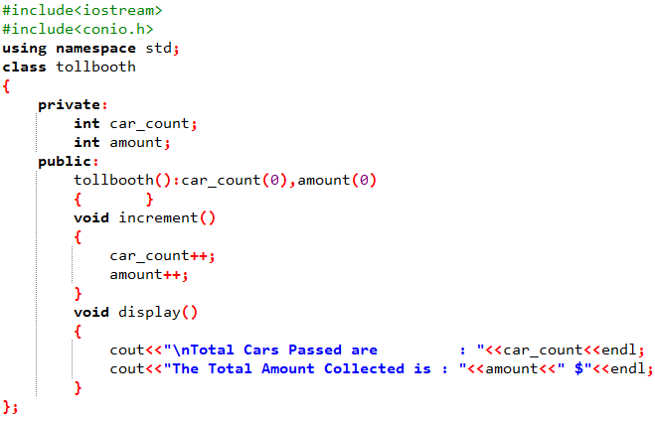
OOP Example
Write an OOP based code to model a tollbooth, every time a car passes, it should increment car_count by 1 and add 1$ in the collected amount. And when ESC key is pressed the total cars passed and total amount collected should display.

Slide 4
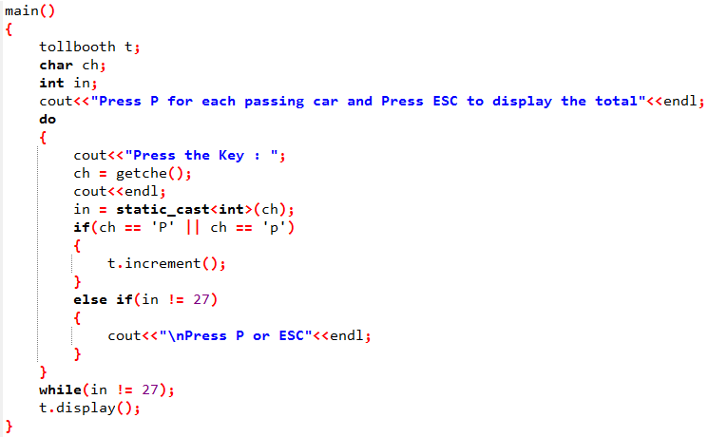
main Program of Previous Example

Slide 5
Analysis of Previous Example
Which of the following is more clear and convenient?
  AnyObject.Some_function();
  OR
  ++AnyObject;
Obviously the use of ++ operator is more clear and user friendly instead of using a function
In OOP it is possible to use ++ operator to get the same result
It can be done with the help of operator overloading

Slide 6
Operator Overloading
To give special meanings to operators, when they are used with user defined classes is called operator overloading
2 + 2 = 4
  The above example is showing that + operator is used to add two integers
2 + myString = 2MyString
  In this example myString is a string and + operator is performing concatenation

Slide 7
Overloading Unary Operators
Unary Operators
  The operators which operates on a single operand are called unary operators
  For example ++, --, ! etc
In order to overload unary operator the “operator” keyword is used
void operator ++()

Slide 8
Overloading Unary Operators
  void operator ++()
Tells the compiler to call member function whenever the ++ operator is called
The compiler distinguish between overloaded operators by looking at data types
If the operand is a basic data type then built-in operator is used
If the operand is an object the compiler will use the user written operator function

Slide 9
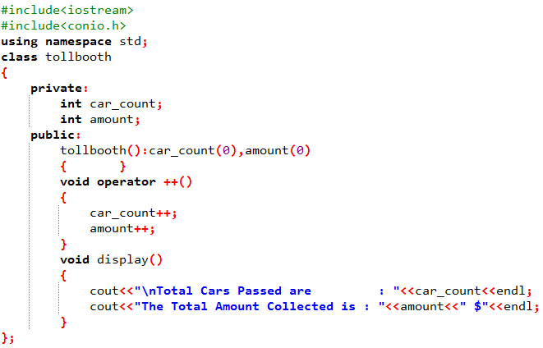
Example 1
Now write the code of previous example (given in slide 3) by using the concept of Operator Overloading.

Slide 10
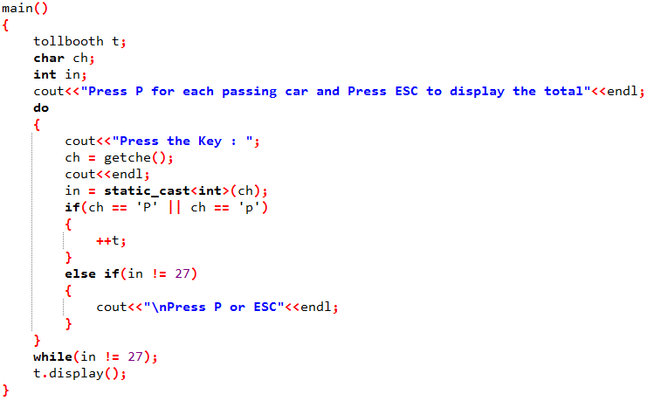
Example 1 (main Program)

Slide 11
Task 1
Write a code by using the concept of operator overloading to implement a tollbooth system. For each passing car the car_count should be incremented by 1 and an amount of 5$ should be added to total, and when user presses the ESC key the total cars passed and total amount should display

Slide 12
Overloading Post Increment Operator
To overload the post increment operator we just write the keyword “int” in the argument of overloaded operator:
void operator ++(int)
The compiler will distinguish between pre and post increment by looking at the argument of operator overloading declaration/definition

